Slide 1
INFSCI 2415: Analysis of Global Life Expectancy
Vishruth Pradeep Reddy | vpr8@pitt.edu |12.04.2023
Data Set Title
Life Expectancy (World Health Organization)
Data from 2000-2015 encompassess 9 regions (179 countries), featuring information on life expectancy, health, immunization, and economic/demographic indicators
Brief Description
Link (Data Set)
https://www.kaggle.com/datasets/lashagoch/life-expectancy-who-updated
Link (GitHub)
https://github.com/vishruthreddy18/Global-Life-Expectancy-Analysis

Slide 2
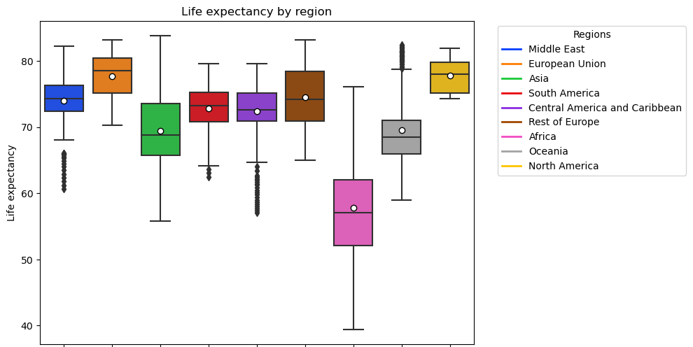
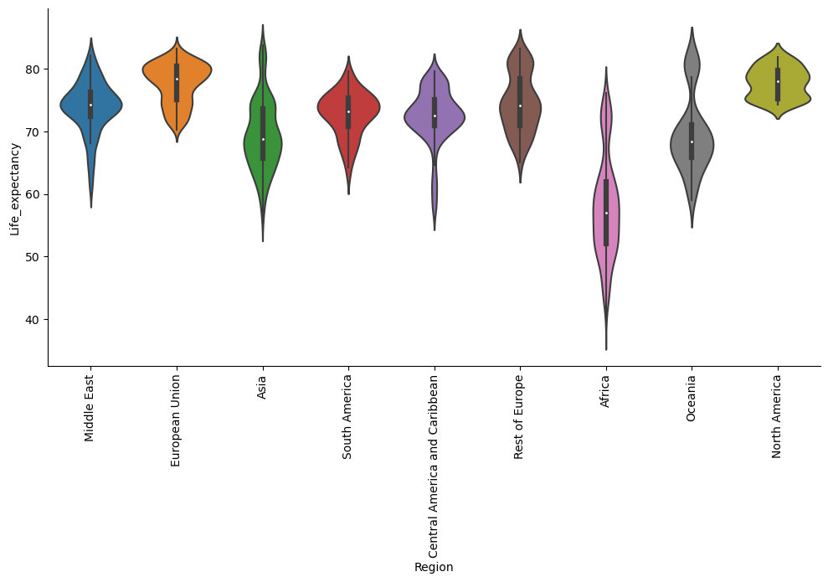
Box Plot & Violin Plot showing the visual summary of Life Expectancy over Various Regions across the Globe
Legend: Each color represents a specific region
KEY OBSERVATIONS
Life Expectancy varies significantly by Region: lowest in Africa and highest European Union
Possible Explanation: healthcare, sanitation, education
Outliers in all regions: shows that individuals present in all regions that live significantly shorter or longer than typical
Possible Explanation: individual factors like genetics or lifestyle choices
Asymmetrical and uneven distribution of life expectancy: Varying box sizes (regions)

Slide 3
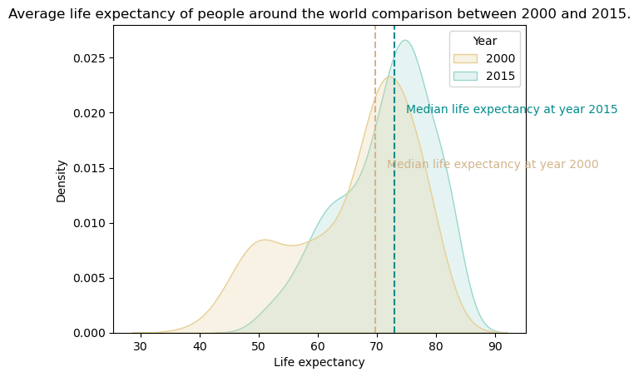
KDE Plot showing the Life Expectancy Density of Individuals across the Globe (years 2000 & 2015)
Legend: Each color represents a specific year
KEY OBSERVATIONS
Global Life Expectancy Soared: observable increases in mean and median life expectancy from 2000 to 2015
Possible Explanation: healthcare, sanitation etc.
Number of individuals with higher life expectancy has increased
Skewness reduced from 2000 to 2015
Plot getting narrower in 2015
Notes:
Overall life expectancy has increased from 2000 to 2015. We can see the increase in the mean and median of the life expectancy.
The plot is getting narrower in 2015 as compared to 2000 showing that the overall life expectancy has increased and is falling in a narrower range.
Skewness has reduced from 2000 to 2015 showing a more definitive range of the life expectancy.

Slide 4
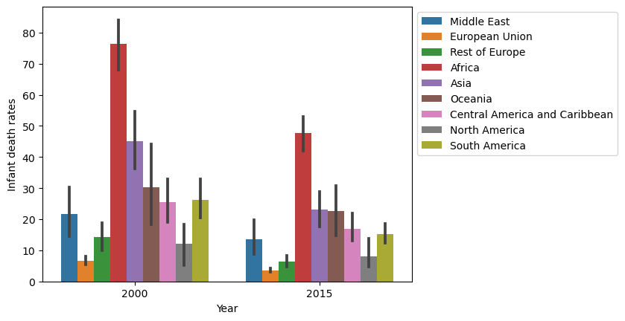
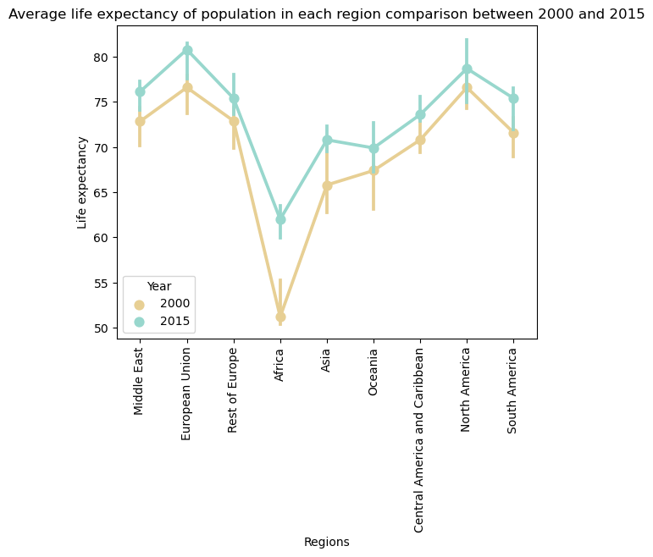
Bar Plot showing Infant Death Rates by Year (per region)
Point Plot showing Life Expectancy by Region (years 2000 & 2015)
Legend: Each color represents a specific region (top) and year (right)
KEY OBSERVATIONS
Regardless of Region, from years 2000 to 2015:
Infant death rate have decreased
Life Expectancy has increased
Life Expectancy and Infant Death Rate are inversely proportional
E.g., Africa has highest infant death rates but lowest life expectancy)
Notes:
Fig 1
Global life expectancy increased between 2000 and 2015. The average life expectancy across all regions rose from about 60 years old in 2000 to nearly 70 years old in 2015.
The rate of increase in life expectancy varied by region. Some regions, such as North America, Oceania, and the European Union, saw faster increases than others, such as Africa and Asia.
Despite the increase, disparities in life expectancy persist. In 2015, people in North America and Oceania could still expect to live, on average, about 10 years longer than people in Africa.
Overall, the data shows that while global life expectancy is improving, there is still a long way to go to ensure that everyone has the opportunity to live a long and healthy life.
Global life expectancy jumped from 60 to 70 years between 2000 and 2015.
North America, Oceania, and the EU outpaced Africa and Asia in life expectancy growth.
Despite the gains, a 10-year life expectancy gap persists between continents.
Fig 2
Infant mortality rates have been steadily declining across all regions since 2000.
In 2015, the Middle East and North Africa had the highest infant mortality rates, followed by sub-Saharan Africa.
High-income regions such as Europe, North America, and Oceania had the lowest infant mortality rates in 2015.
I hope this is helpful!

Slide 5
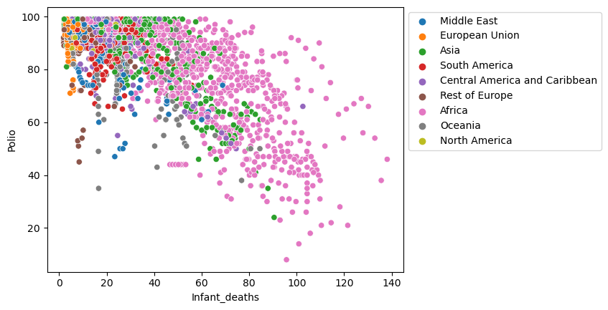
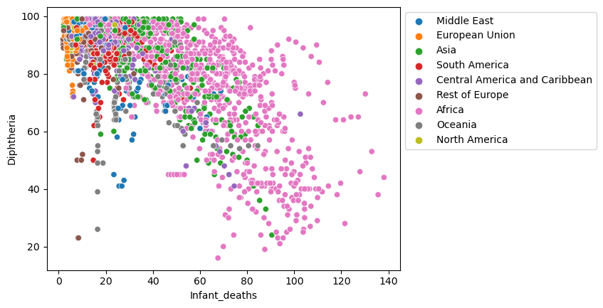
Scatter Plot showing distribution of % population vaccinated (Polio or DTP) vs Infant Death Rate (by Region)
KEY OBSERVATIONS
Disparities in the distribution of healthcare observed across different regions
E.g., Vaccine coverage lower in Africa and Asia compared to EU and North America
Infant Death Rates are inversely proportional to vaccination coverage in the population
Regions with lower vaccination coverage have a higher infant death rate (e.g., Africa and Asia)
Regions with higher vaccination coverage have a lower infant death rate (e.g., EU and North America)
Legend: Each color represents a specific region
Notes:
3 Key Points: Infant Mortality Rate Map
Global Disparity: The map highlights stark differences in infant mortality, with Africa and South America bearing the heaviest burden compared to Europe, North America, and Oceania. This underscores the uneven distribution of healthcare and living conditions worldwide.
Outdated Data: The map's reference to "polio" suggests its creation predates widespread polio vaccination, potentially rendering the depicted rates inaccurate for the contemporary world.
Misleading Representation: The dot distribution, while providing a general picture of high and low rates, fails to account for population density. A small country with a high rate could have the same dot count as a large country with a low rate, distorting the true picture.
These points emphasize the need for cautious interpretation when analyzing the map, acknowledging its limitations alongside the valuable insights it offers.
3 Key Points: Infant Mortality Map
Global Gap: Stark differences exist. Africa & South America suffer high rates, while Europe, North America & Oceania fare much better. Healthcare & living conditions disparities laid bare.
Outdated Data: Map's "polio" reference suggests pre-vaccine era data. Rates depicted may not reflect the current reality.
Misleading Dots: Dot distribution paints a general picture, but ignores population density. A small, high-rate country could have same dot count as a large, low-rate one.
Interpret with caution. Valuable insights, but limitations need consideration.
Fig 2
Sure, here are 3 important points from the image:
Infant mortality rates vary greatly across the world. The countries with the highest rates are in Africa, while the countries with the lowest rates are in Europe and North America.
There is a clear correlation between infant mortality rates and economic development. The countries with the highest rates are also the poorest countries in the world.
The good news is that infant mortality rates have been declining in recent decades. This is due to a number of factors, including improved access to healthcare, better sanitation, and increased education levels.
I hope this helps! Let me know if you have any other questions.

Slide 6
THANK YOU!

